Slide 1
EARTH DAY

Slide 2
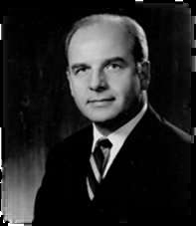
ORIGIN OF THE EARTH DAY
The first Earth Day was in 1970. Nelson, after seeing the damage done by a 1969, massive oil spill in Santa Barbara, California, was inspired to organize a national "teach-in" that focused on educating the public about the environment.
Nelson recruited Denis Hayes as national coordinator, and persuaded U.S. Rep. Pete McCloskey of California to be the co-chairman. They rallied 20 million people across the United States on April 20, 1970. Universities held protests, and people gathered in public areas to talk about the environment and find ways to defend the planet.
In 1995, President Bill Clinton awarded Nelson the Presidential Medal of Freedom for being the founder of Earth Day. This is the highest honor given to civilians in the United States.
“THE NEXT TEN YEARS MAY BE MORE IMPORTANT THAN THE LAST TEN THOUSAND DETERMINING THE
FATE OF OUR OCEANS.”

Slide 3
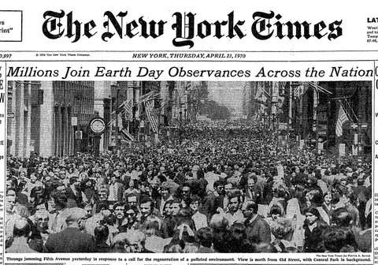
FIRST EARTH DAY
The first Earth Day celebrations took place in two thousand colleges and universities, roughly ten thousand primary and secondary schools, and hundreds of communities across the United States.
Today it is observed in 192 countries, and coordinated by the nonprofit Earth Day Network, chaired by the first Earth Day 1970 organizer Denis Hayes, according to whom Earth Day is now “The largest secular holiday in the world, celebrated by more than a billion people every year.”
“ Walt Kelly created an anti-pollution poster featuring his comic strip character Pogo with the quotation "We have met the enemy and he is us" to promote the 1970 Earth Day.
“WHEN ONE TUGS AT A SINGLE THING IN NATURE, HE FINDS IT ATTACHED TO THE REST OF THE WORLD.”

Slide 4
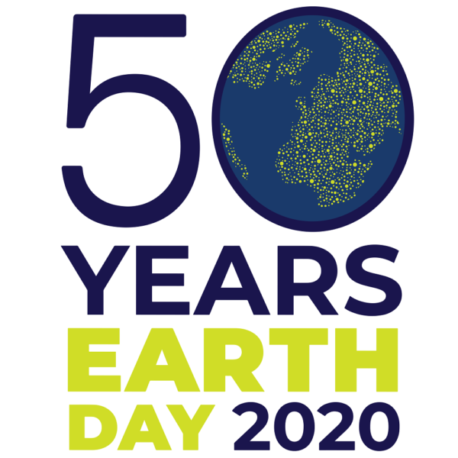
THEME OF EARTH DAY
The theme for Earth Day 2020 is climate action. The enormous challenge — but also the vast opportunities — of action on climate change have distinguished the issue as the most pressing topic for the 50th anniversary.
“NATURE IS NOT MUTE, IT IS MAN WHO IS DEAF.”

Slide 5
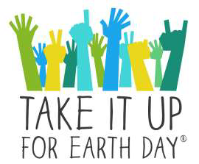
FACTS ABOUT EARTH DAY
The first Earth Day was celebrated on April 22, 1970.
Earth Day originated in the US but became recognized worldwide by 1990.
On Earth Day 2009, Disney released a documentary film called Earth that followed the migration paths of four animal families.
On the very first Earth Day, 20 million people gathered in the streets of America to protest the industrial revolution. An environmental movement was born as a result.
Every year on April 22, men, women, and children collect garbage, plant trees, clean up coral reefs, show movies, sign petitions, and plan for a better future for our planet.
Recycle old or worn-out clothes to help our planet.
Gaylord Nelson founded Earth Day while he was working as a US senator.
Earth Day was renamed officially by the UN in 2009 as International Mother Earth Day.
Some schools and communities celebrate Earth Day for a whole week to expand the time frame that people focus on the earth and how they can preserve it.
“HUMANS ARE THE ONLY CREATURES ON EARTH THAT WILL CUT DOWN A TREE,TURN IT INTO A PAPER,THEN WRITE”, “SAVE THE TREES” ON IT

Slide 6
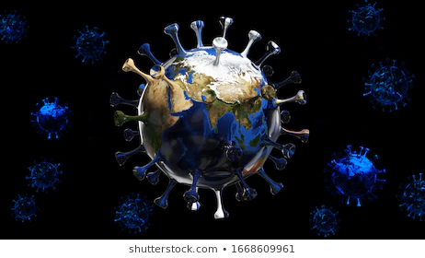
COVID-19 & EARTH’S ATMOSPHERE
As the coronavirus pandemic impacts millions across the world and brings economies to a grinding halt, there is a lot of talk about how emissions from fossil fuel combustion have dropped radically in many countries. Yet this is no solution to air pollution and climate change. For while eerily empty cities may be bathed in blue skies, millions are suddenly out of work and wondering how they are going to care for their families.
The poor and most vulnerable will suffer most from both the health impacts and the economic crisis. Cleaner air for a few months may be a tiny silver lining to COVID-19’s dark clouds, but will do little in the long run to solve the problem of outdoor air pollution that kills more than four million people every year. For what we need to kick our habit of burning coal, oil and gas.
“WHEN YOU REALISE HEART & EARTH ARE SPELLED WITH THE SAME LETTERS, IT ALL STARTS TO MAKE SENSE.”

Slide 7
“IT IS TIME TO RETURN THE FAVOUR OF MOTHER EARTH BY PLANTING MORE TREES, BY CONTROLLING POLLUTION AND BY MAKING IT A GREENER PLANET. LET US THANK EARTH BY TAKING CARE OF IT.”

Slide 8
THANK YOU

